Slide 1
Case Analysis Jan 23, 2020
Yuping

Slide 2





Contents
Problem Space Key Insights Modeling Recommendation Testing Plan

Slide 3
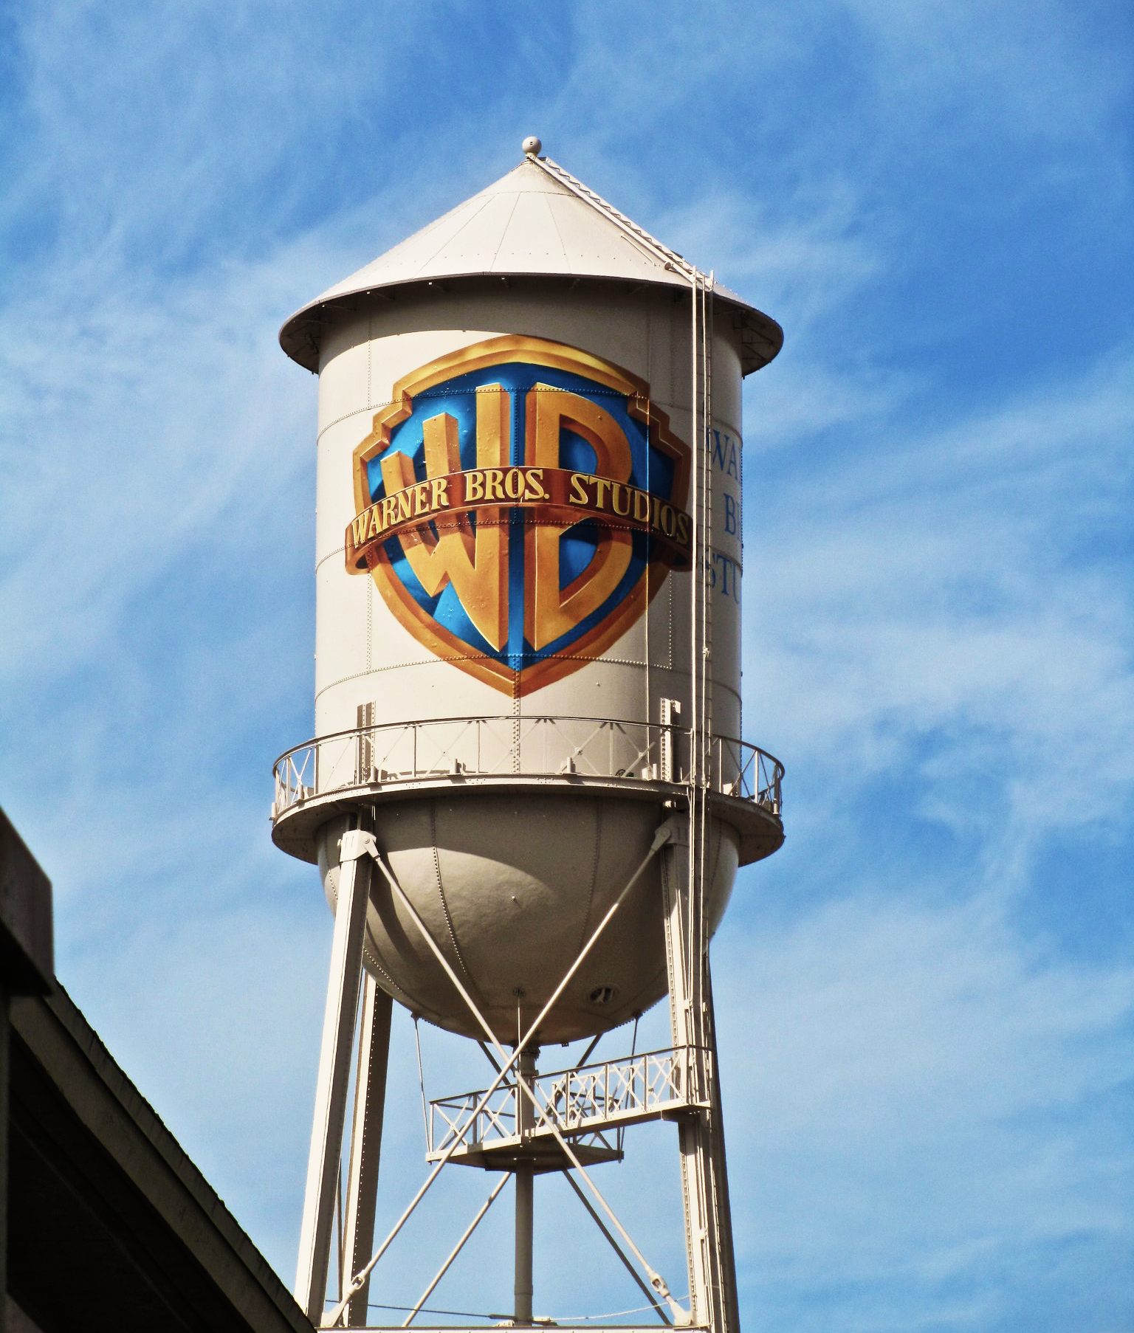
Contents
Objectives
Data & Pre-Diagnostics
Model Results
Full Model Results
Cross Validation Result
Realized Effects
Post Diagnostics
Concept
Parallel Custom Objective
Model and Helper Classes
Next Steps

Slide 4
Objectives
Business Objectives
Forecast weekly or daily digital transactions and consumer spend.
Quantify the impact of features on the transactions and consumer spend.
Analytical Objectives
Use a model that analyze a broad range of input features.
Use a model that accepts missing values in the input features.
Use a model that can detect and analyze potentially complicated feature interactions.
Development Objectives
Explore and develop several different gradient boosting approaches.

Slide 5
Contents
Objectives
Data & Pre-Diagnostics
Model Results
Full Model Results
Cross Validation Result
Realized Effects
Post Diagnostics
Concept
Parallel Custom Objective
Model and Helper Classes
Next Steps

Slide 6
Data and Pre-Diagnostics
Data
Overview of features used in model
Walk-through of viewership data transformation
Pre-Diagnostics
Observation Distribution by Feature Value

Slide 7


Data Features
Features by Effect
Trend 3 features | Title Trend 4 features | Pricing 8 features
Fiscal year Amazon terms indicator Amazon terms duration | Broadcast season number indicator Episodic season number Lifecycle qualifier (new release) Week of release | EST HD/SD episode/season VOD HD/SD episode/season

Slide 8



Data Features (Cont.)
Features by Effect
Promotion 1 feature | SVOD 18 features | Viewership 4 features
Promotion indicator | Series and title interaction Series duration Title duration (across Netflix, Hulu, Amazon Prime, HBO, CBS, IMDB) | Time slot: all time, prime time Gender: male, female Age group: 18 – 24 year-old

Slide 9
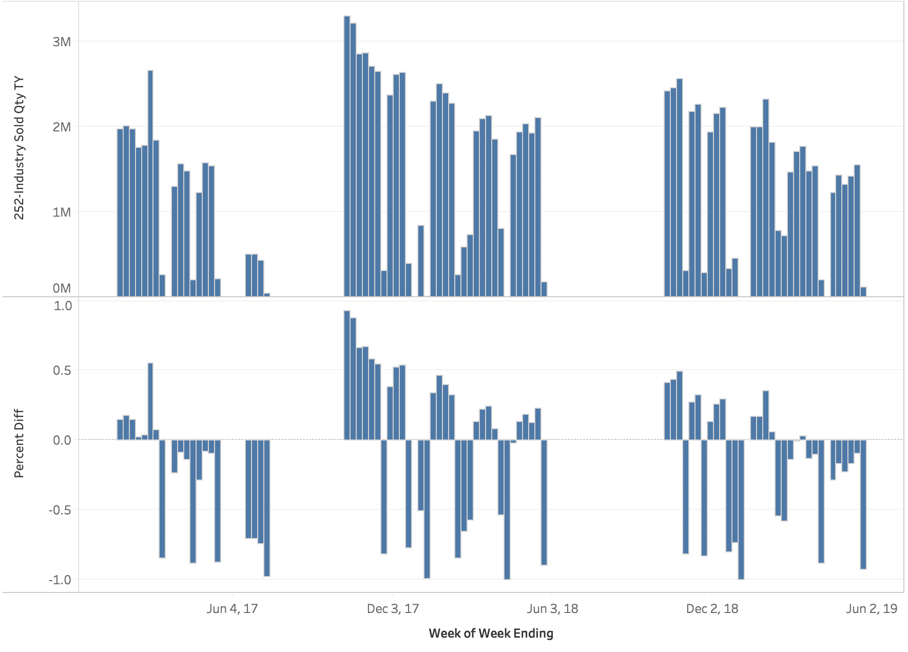
Viewership Transformation Walk-Through
Viewership Analysis – Riverdale (All Viewers)
- Weekly data
- Series (Subject) level
- Empty values
- Percent difference
to median (catching trend)
in each group

Slide 10
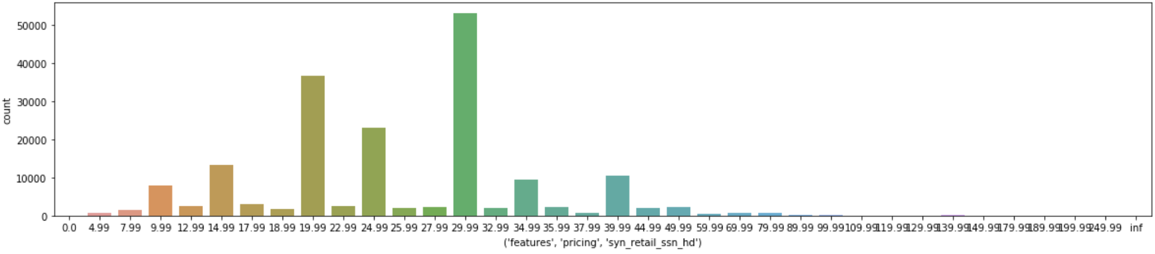
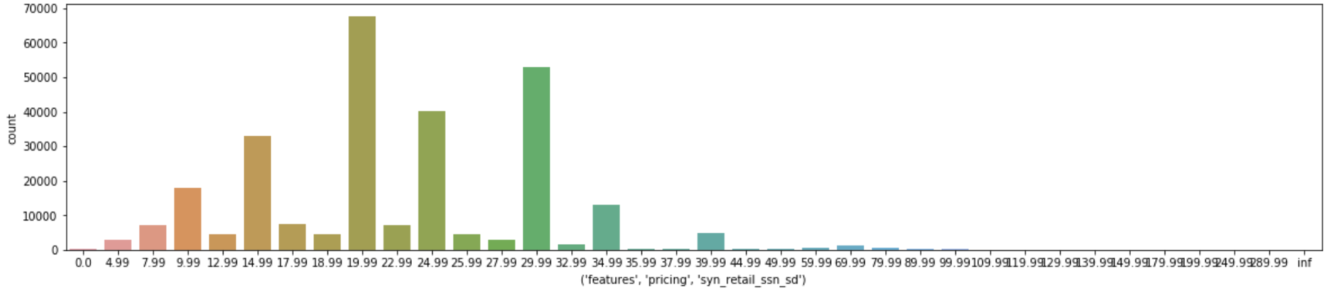
Pre-Diagnostics
Observation Distribution by Feature Value: EST Season Price (All model groups)
Notes:
MPB - Pre-Diagnostics v6.ipynb

Slide 11
Contents
Objectives
Data & Pre-Diagnostics
Model Results
Full Model Results
Cross Validation Results
Realized Effects
Post Diagnostics
Concept
Parallel Custom Objective
Model and Helper Classes
Next Steps

Slide 12
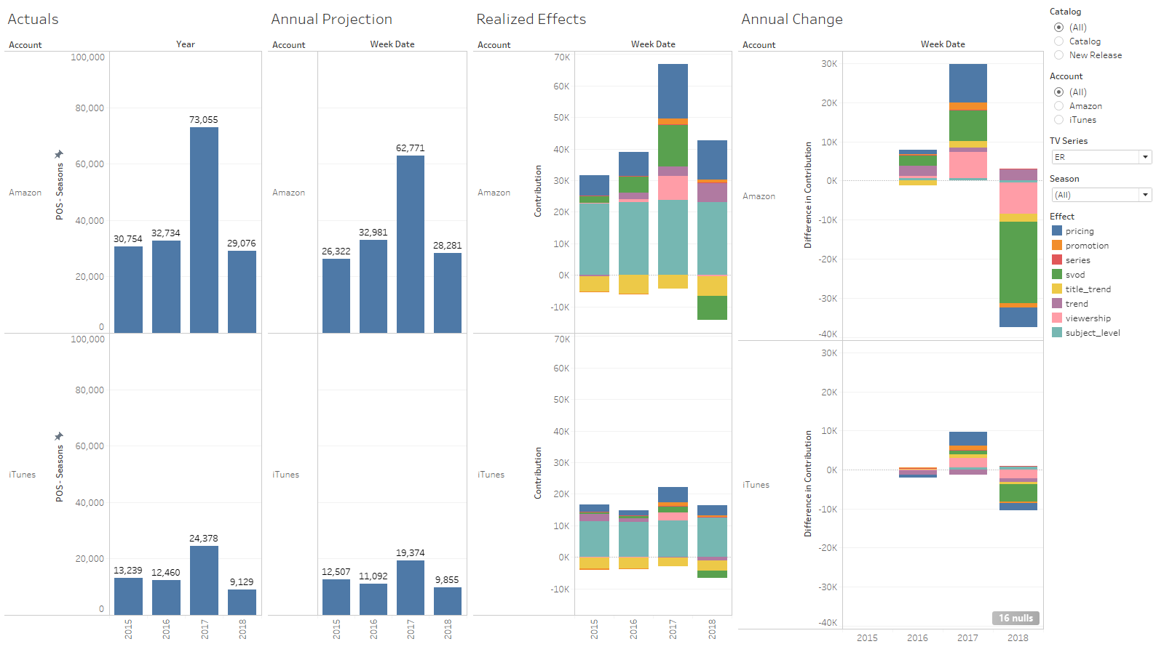
Realized Effect Example (ER)

Slide 13
Full Model and Cross Validation Results
Go to Full Model notebook
Go to Cross Validation notebook

Slide 14
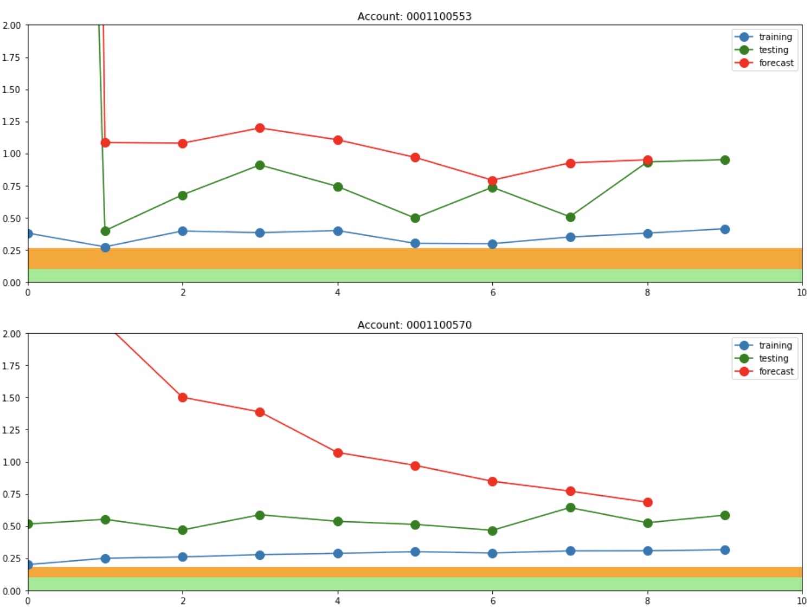
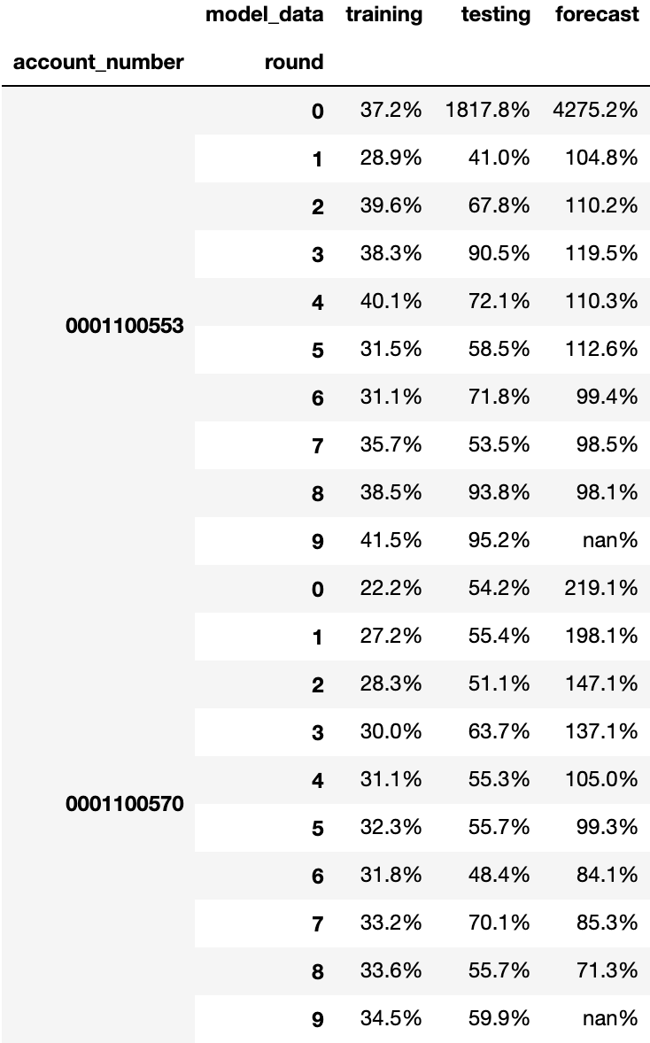
Cross Validation Results
MAPE Benchmark (Results in original scale)
Notes:
MPB - Post Diagnostics v21.ipynb
3. MAPE Benchmark

Slide 15
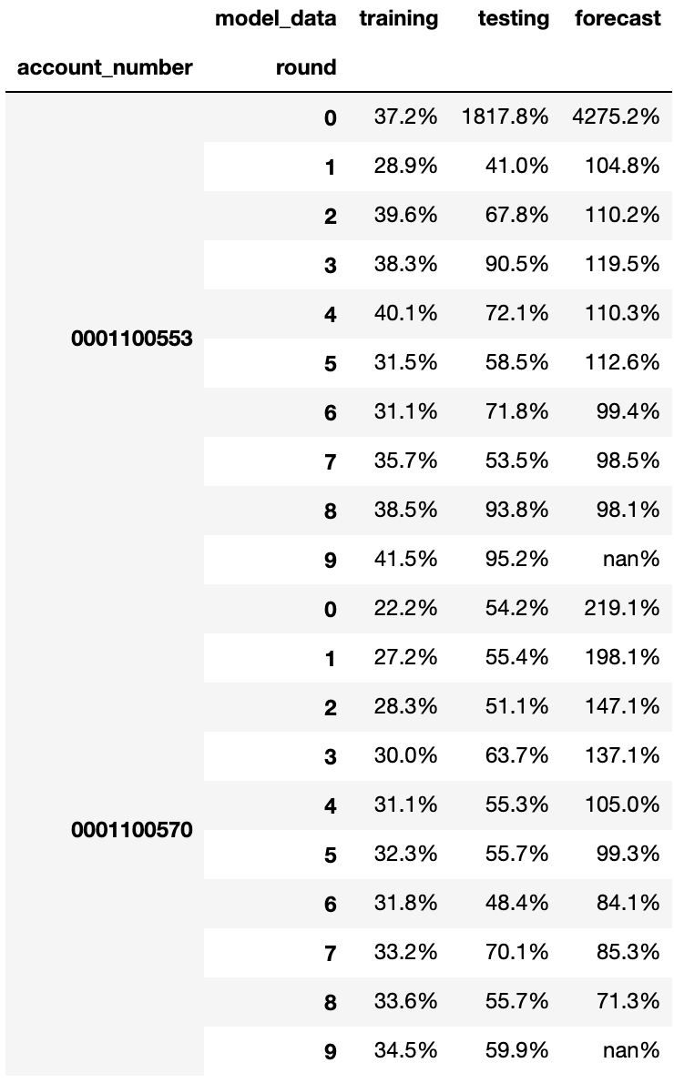
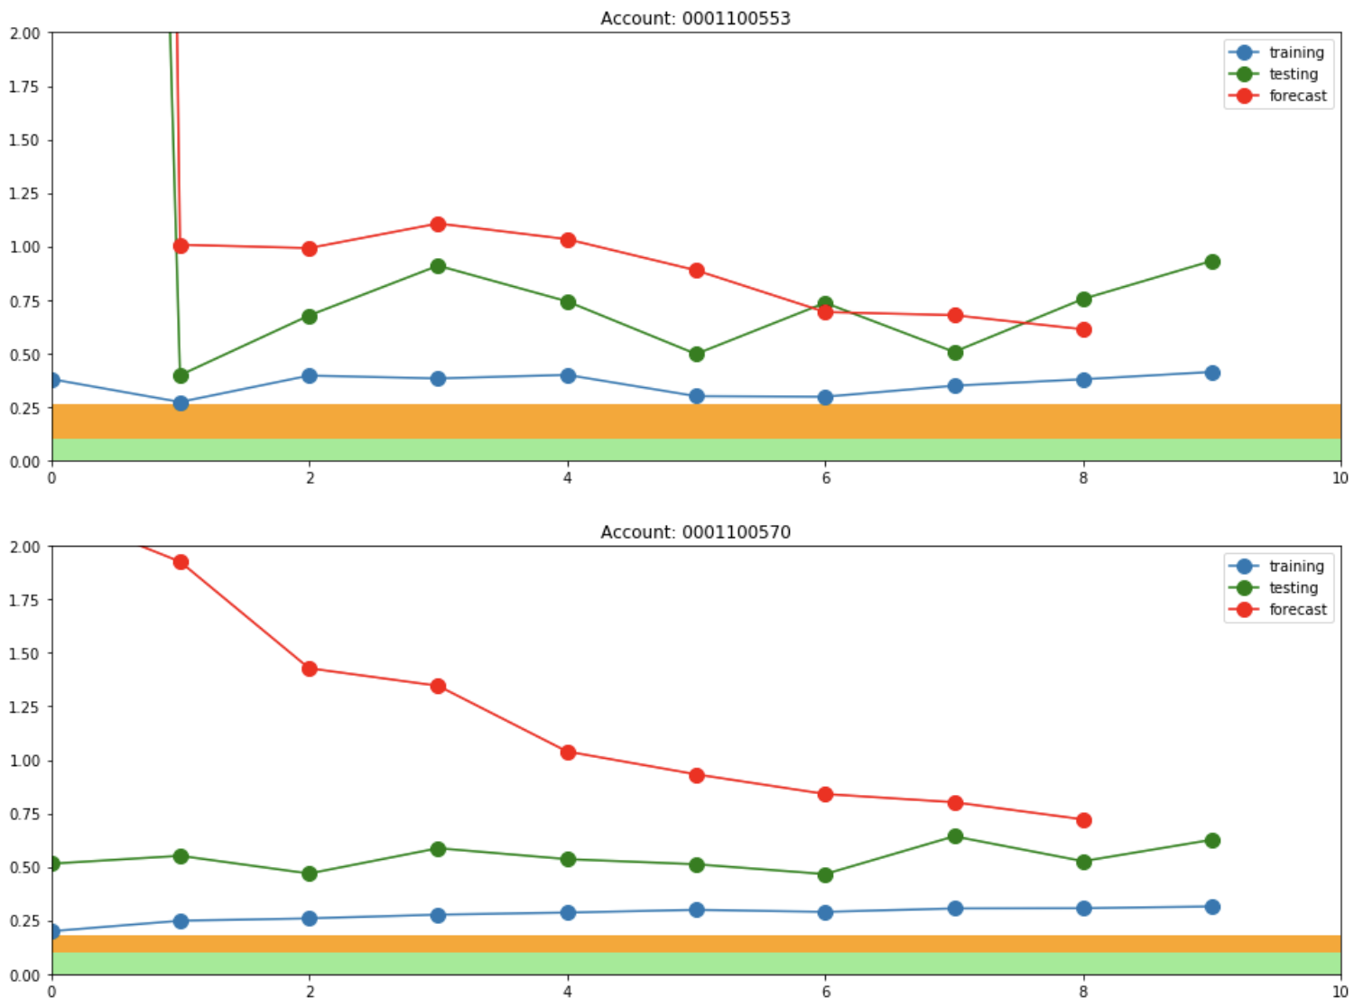
Cross Validation Results (Cont.)
MAPE Benchmark (Results in original scale, and not including Amazon out-of-term period)
Notes:
MPB - Post Diagnostics v21.ipynb
3. MAPE Benchmark

Slide 16
Effects
Organize features into logical groups to help with
model interpretation
business insights
This effect groups are NOT used by the model
They are used to help
organize features
summarize the results
Notes:
We organize our features into logical groups to help with model interpretation and business insights.
This effect groups are NOT used by the model. They are just used to help us organize our features and summarize the results.

Slide 17
Realized Effects
Log transform target (season transactions)
Correct for the varying scale / magnitude of sales
Represent features and effects as multiplicative impacts
Translate these multiplicate impacts into unit impacts (original scale)
Help understand and interpret the model
To realize the effects in the original scale, see the following logic
Notes:
Realized Effects:
We are are log transform our target (season transactions) to correct for the varying scale/magnitude of sales across our diverse TV catalog.
While we can represent our features and effects as multiplicative impacts, we also want to translate these multiplicate impacts into “unit” impacts to help us understand and interpret the model.
Therefore we use the following logic to “realize” the effects in the original scale:

Slide 18
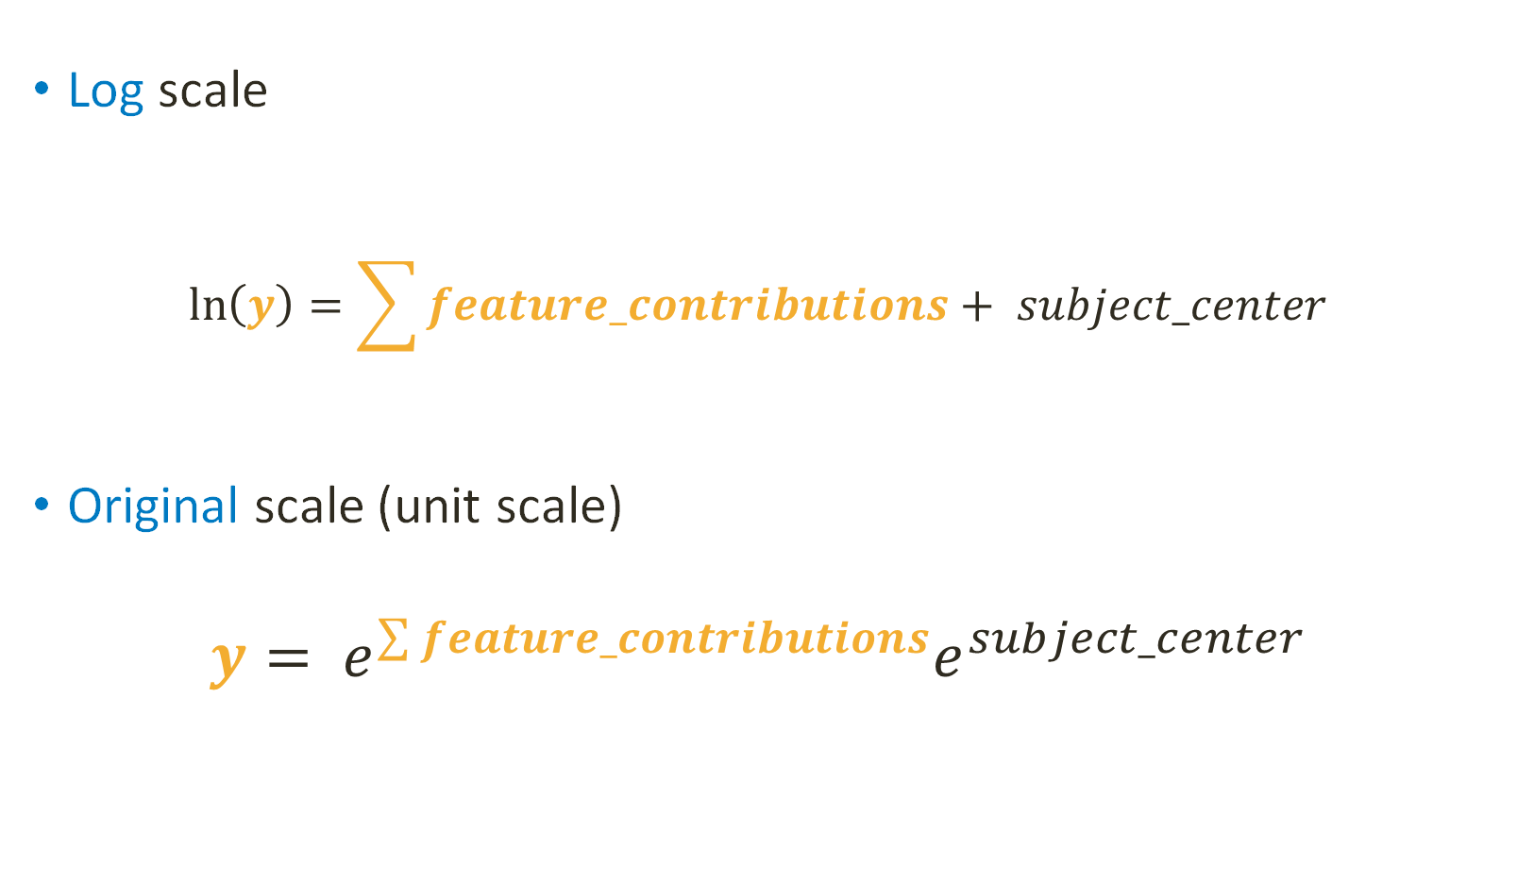
Logic of Realized Effect
Log scale
$$\ln\left(y\right)=\sum{feature_contributions}+ subject_center$$
Original scale (unit scale)
$$y= e^{\sum{feature_contributions}}e^{subject_center}$$

Slide 19
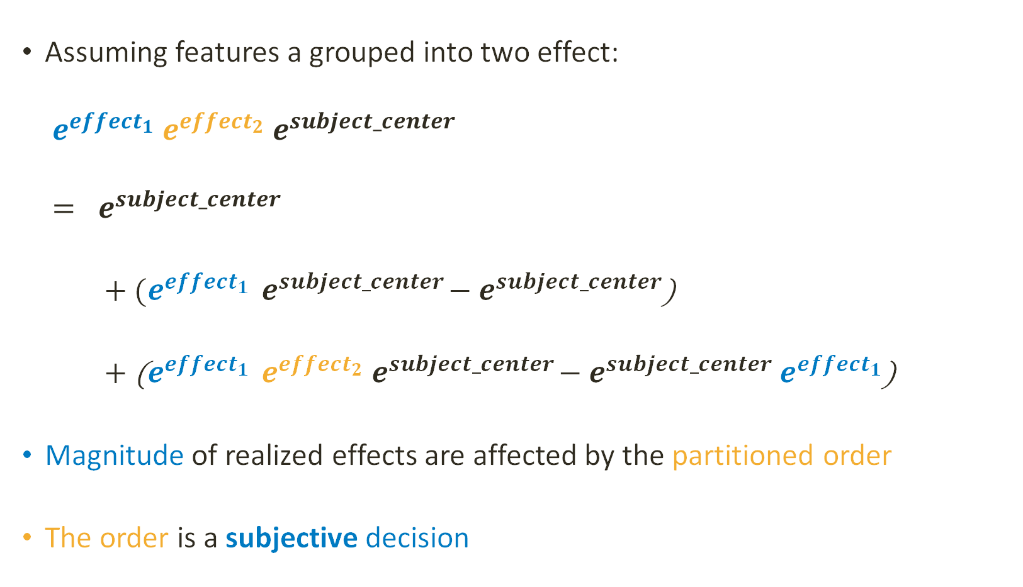
Logic of Realized Effect (Cont.)
Assuming features a grouped into two effect:
$$e^{{effect}_{1}}{ e}^{{effect}_{2}}{ e}^{subject_center}$$
$$= e^{subject_center}$$
$+ (e^{{effect}_{1}}{ e}^{subject_center}−$ $e^{subject_center}$)
$+$ ($e^{{effect}_{1}}{ e}^{{effect}_{2}}{ e}^{subject_center}−$ $e^{subject_center}$ $e^{{effect}_{1}}$)
Magnitude of realized effects are affected by the partitioned order
The order is a subjective decision
subject effect
realized effect #1
realized effect #2

Slide 20
Contents
Objectives
Data & Pre-Diagnostics
Model Results
Full Model Results
Cross Validation Result
Realized Effects
Post Diagnostics
Concept
Parallel Custom Objective
Model and Helper Classes
Next Steps

Slide 21
Post Diagnostics
Residuals (Errors)
All residuals
Residuals by feature values
Feature Contribution Visualization Tool
Error Detector Tool (error investigation example)

Slide 22
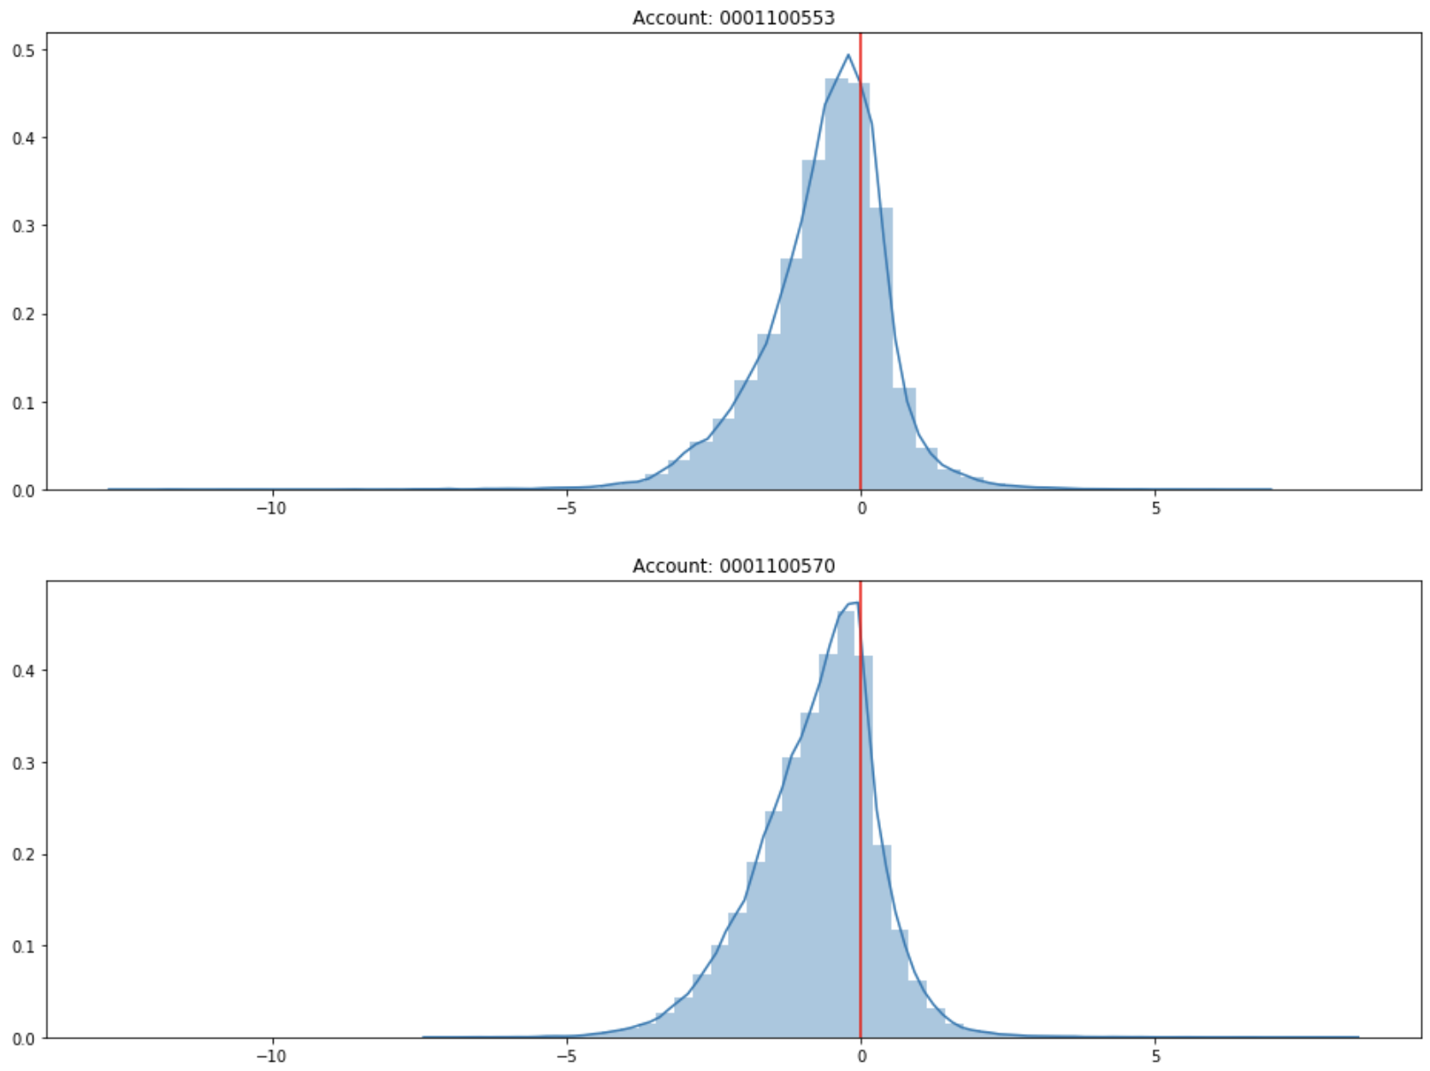
Post Diagnostics – Residuals
Full-Model Residual Distribution (log scale)
The model is biased, so the residual distribution is skewed
Notes:
MPB - Post Diagnostics v21.ipynb
5. Residual Distribution

Slide 23
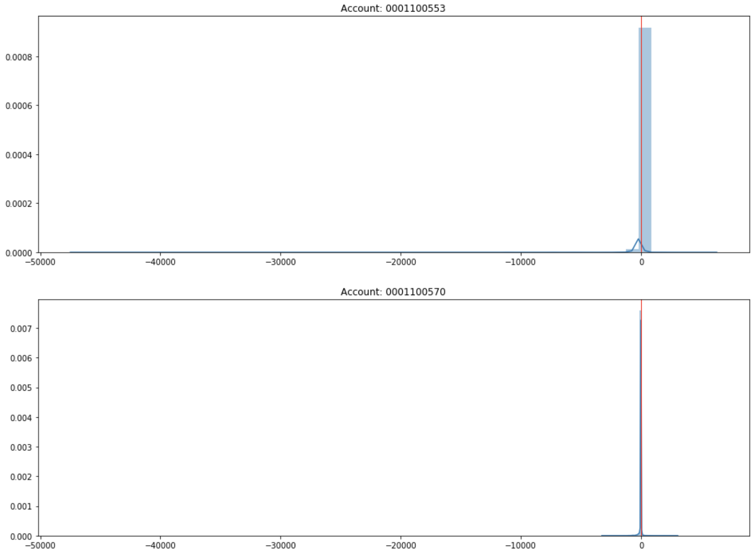
Post Diagnostics – Residuals (Cont.)
Full-Model Residual Distribution (original scale)
Notes:
MPB - Post Diagnostics v21.ipynb
5. Residual Distribution

Slide 24
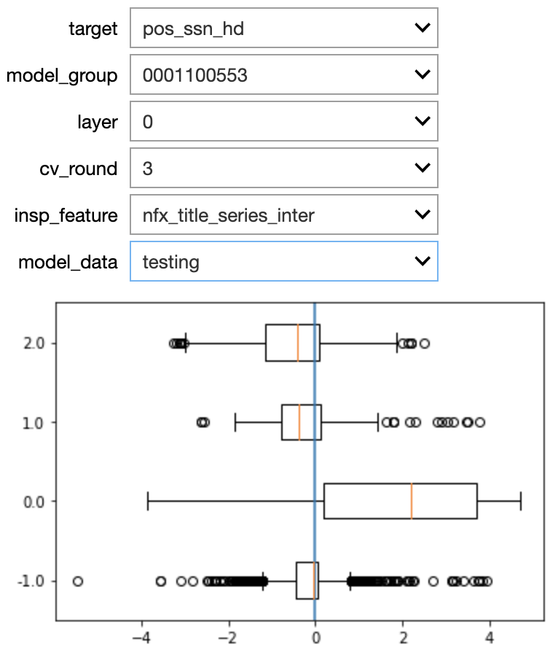
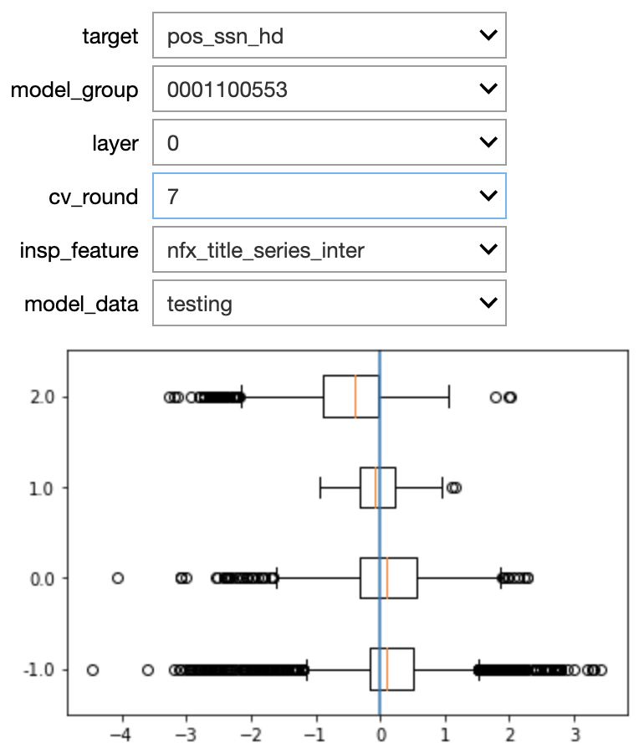
Post Diagnostics – Distribution by Feature Value
Residual Distribution by Feature
The skewed distribution has been improved from CV round 3 to round 7
Notes:
MPB - Post Diagnostics v21.ipynb
7.2 Residual Distribution by Feature

Slide 25
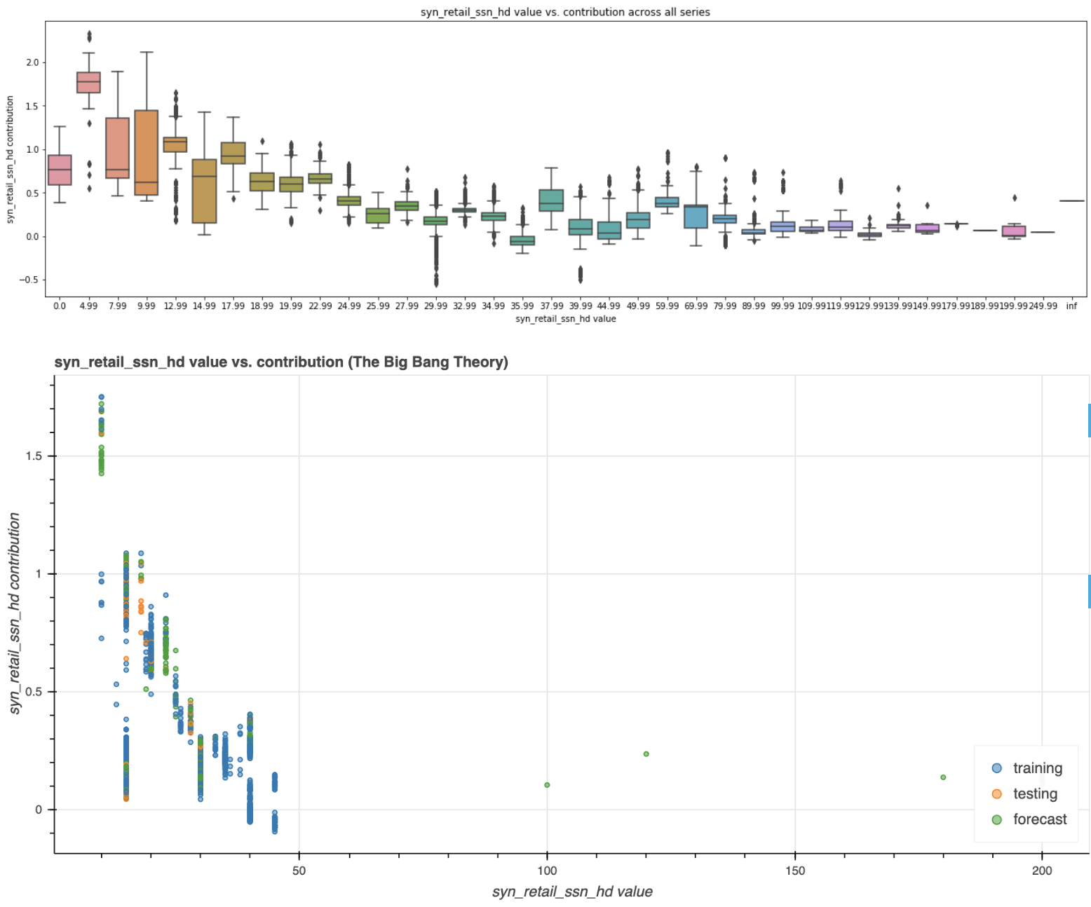
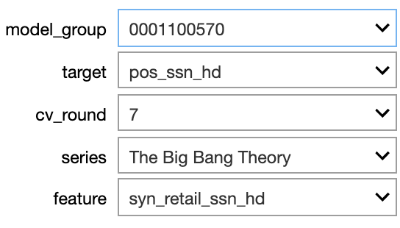
Post Diagnostics – Feature Contribution Visual
Contribution Weight Visualization
EST Season HD Price Contribution
Elastic curve
Notes:
MPB - Post Diagnostics v21.ipynb
4. Contribution Weight Visualization

Slide 26
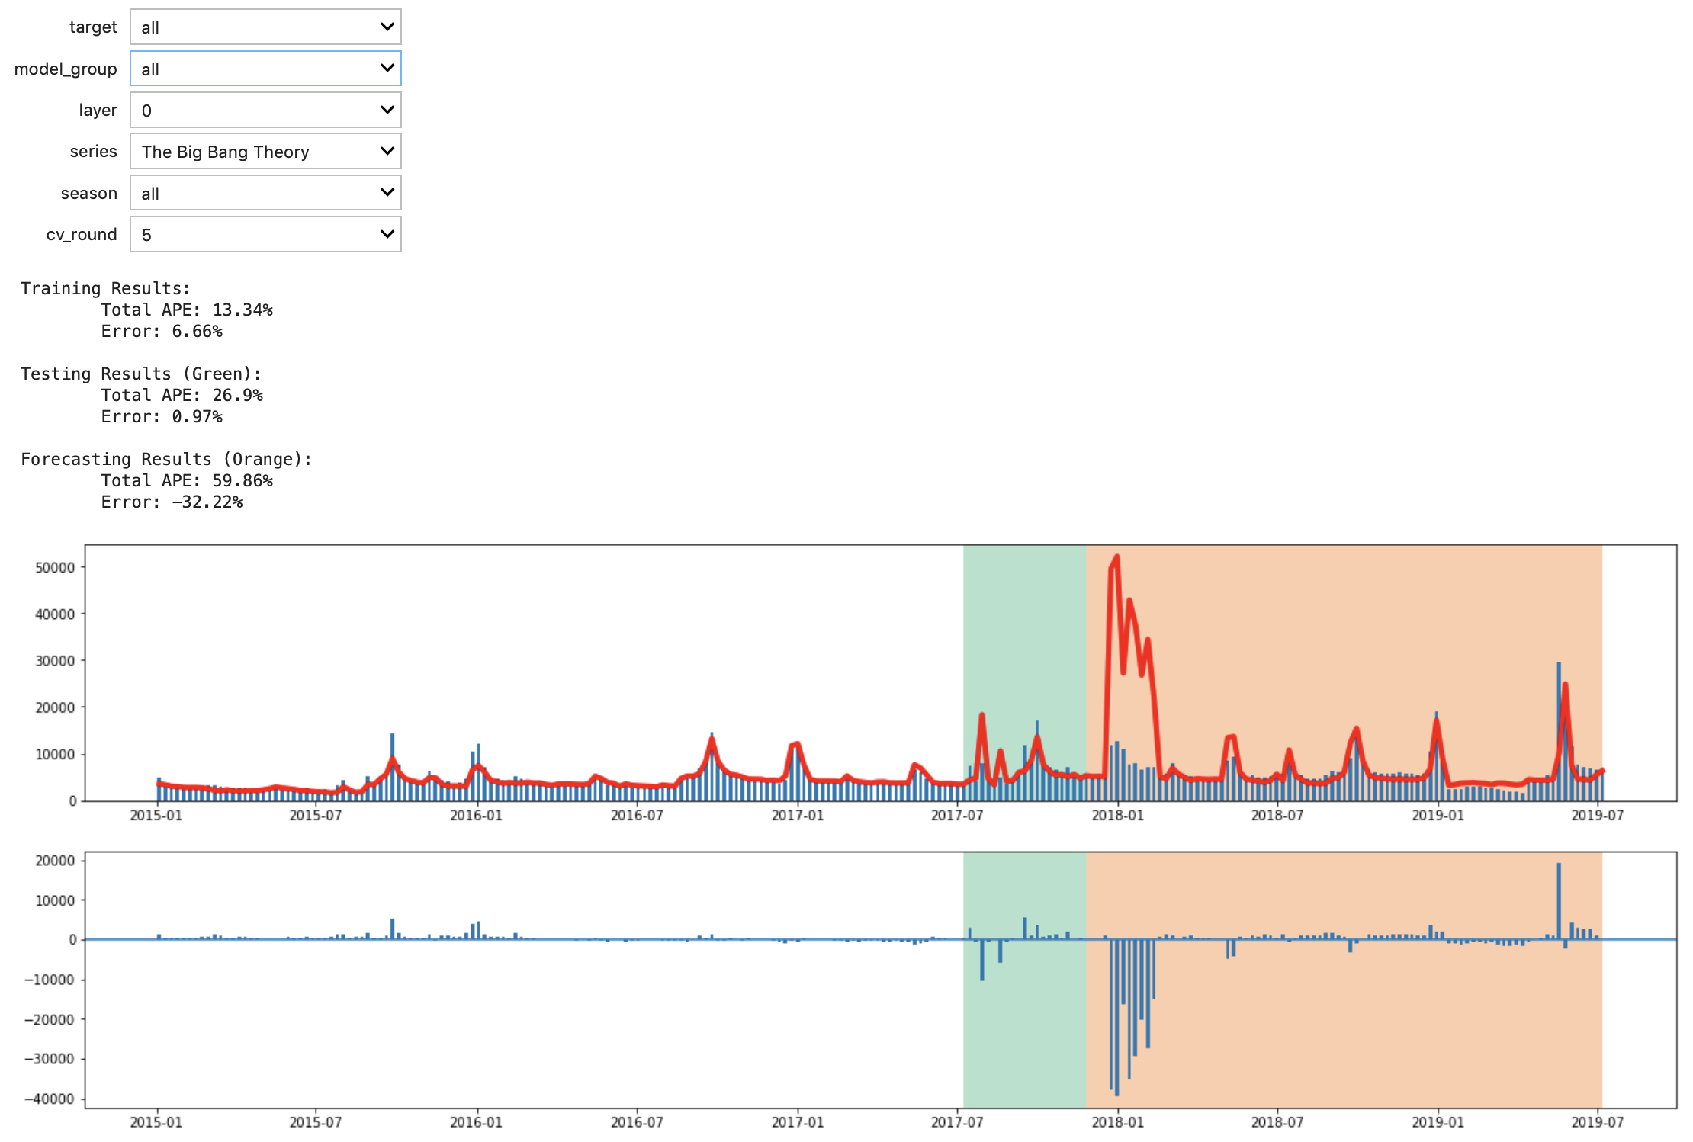
Post Diagnostics Investigation
Cross-validation Results Investigation Example
Result visual from model fitting
Forecast went haywire in CV round 5 of The Big Bang Theory
Notes:
MPB - Model Fitting.ipynb

Slide 27
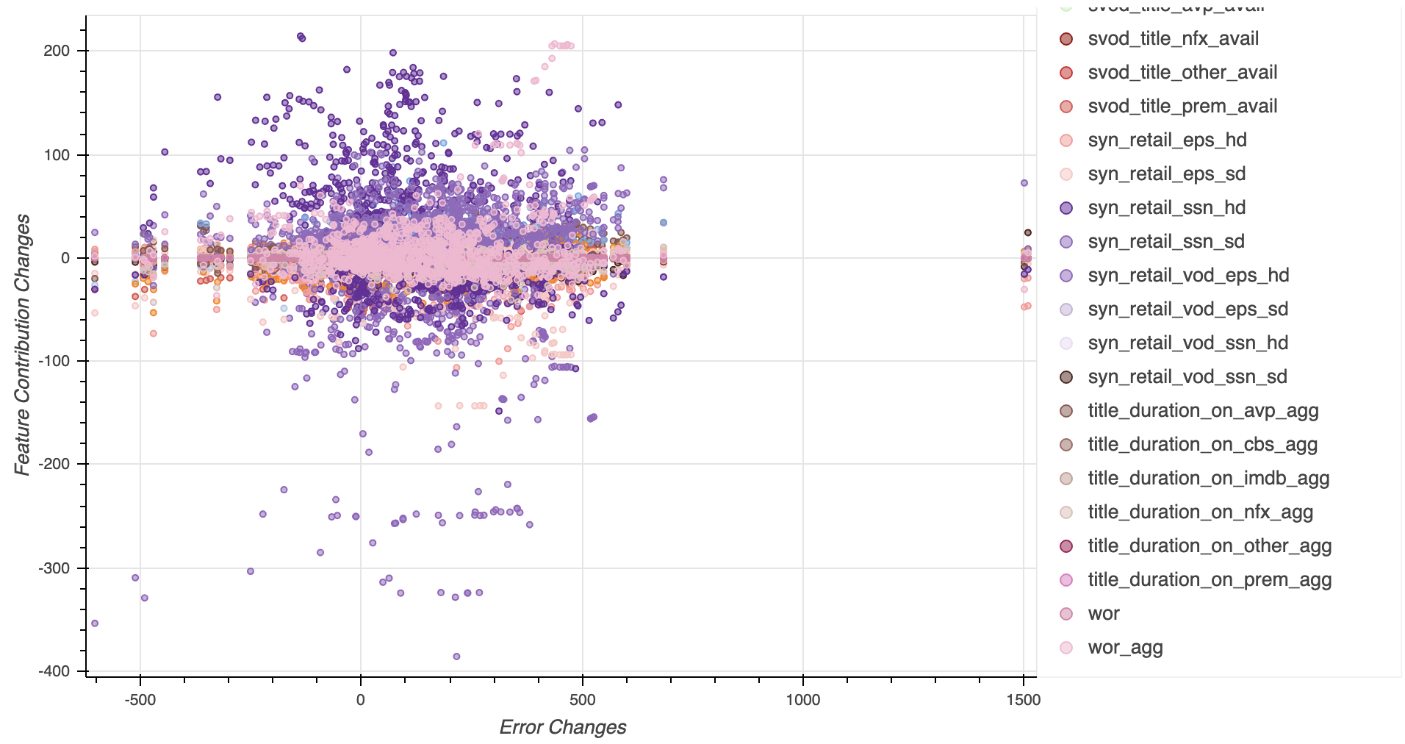
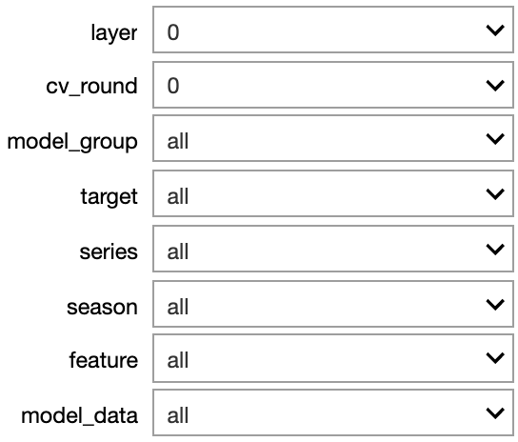
Post Diagnostics – Error Source Detector
Error Source Detector Overview:
Changes in Residuals (Error Changes) vs. Changes in Feature Contribution
Features are marked in different colors
Notes:
MPB - Post Diagnostics v21.ipynb
6. Error Source Detector

Slide 28
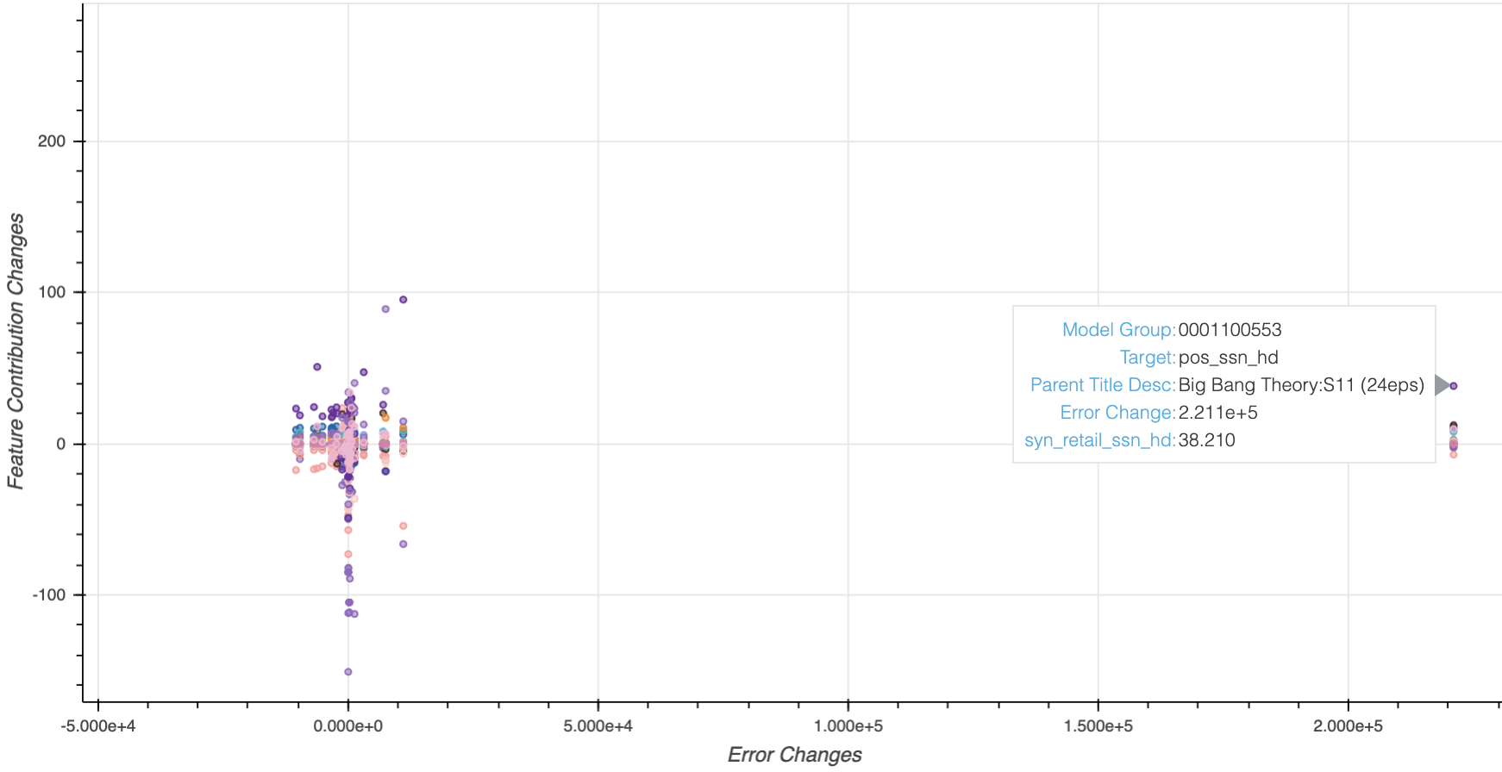
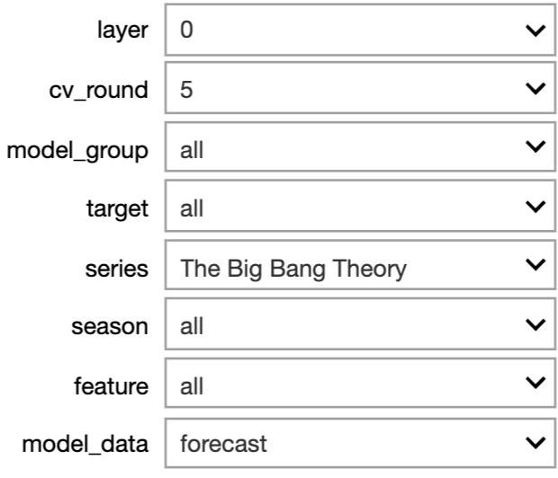
Error Investigation Example
Select data points according to CV results investigation
EST Season Price in Season 11 contributes the most to residual changes
Notes:
MPB - Post Diagnostics v21.ipynb
6. Error Source Detector

Slide 29
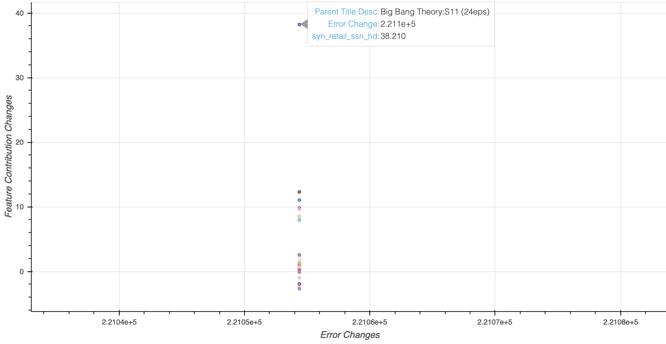
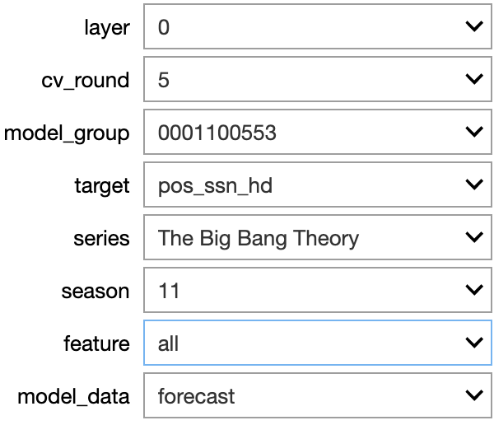
Error Investigation Example
All feature contribution changes for The Big Bang Theory Season 11
Ranked #1: EST Season HD Price
Warner Bros. Home Entertainment – Television Marketing
29
Notes:
MPB - Post Diagnostics v21.ipynb
6. Error Source Detector

Slide 30
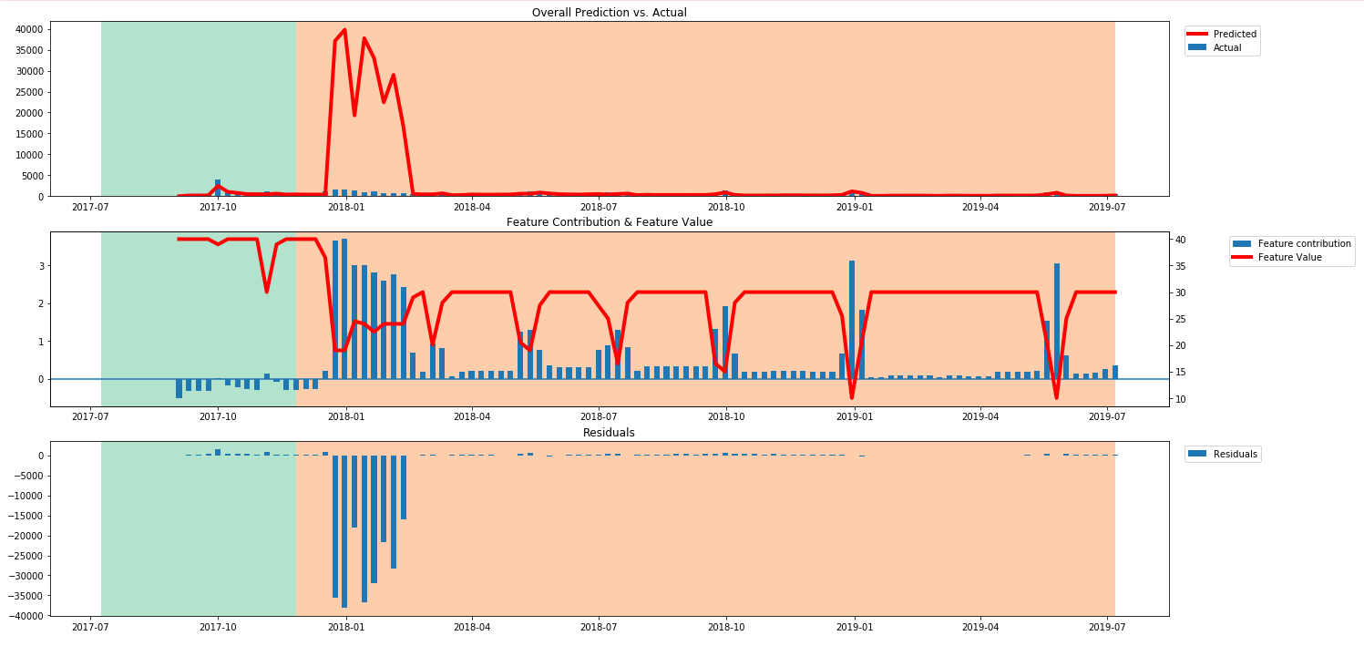
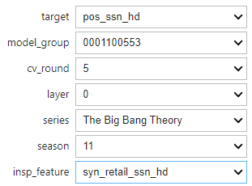
Error Investigation Example
Ranked #1: EST Season HD Price
Notes:
Post-diagnostics NB #7.1

Slide 31
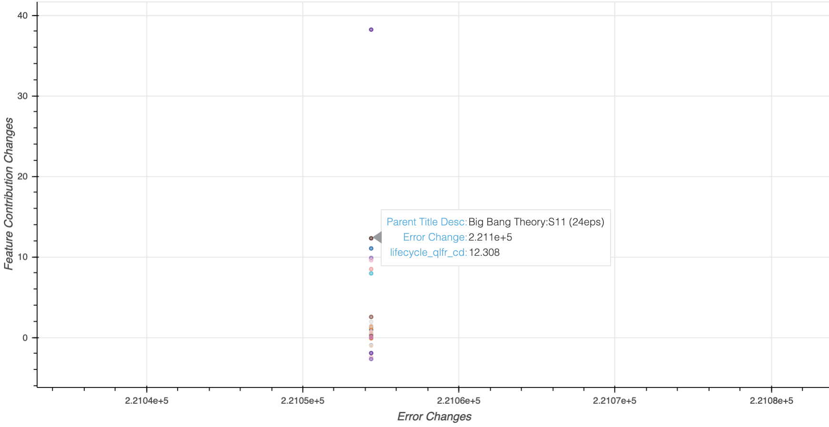
Error Investigation Example
All feature contribution changes for The Big Bang Theory Season 11
Ranked #2: Lifecycle Qualifier
Warner Bros. Home Entertainment – Television Marketing
31
Notes:
MPB - Post Diagnostics v21.ipynb
6. Error Source Detector

Slide 32
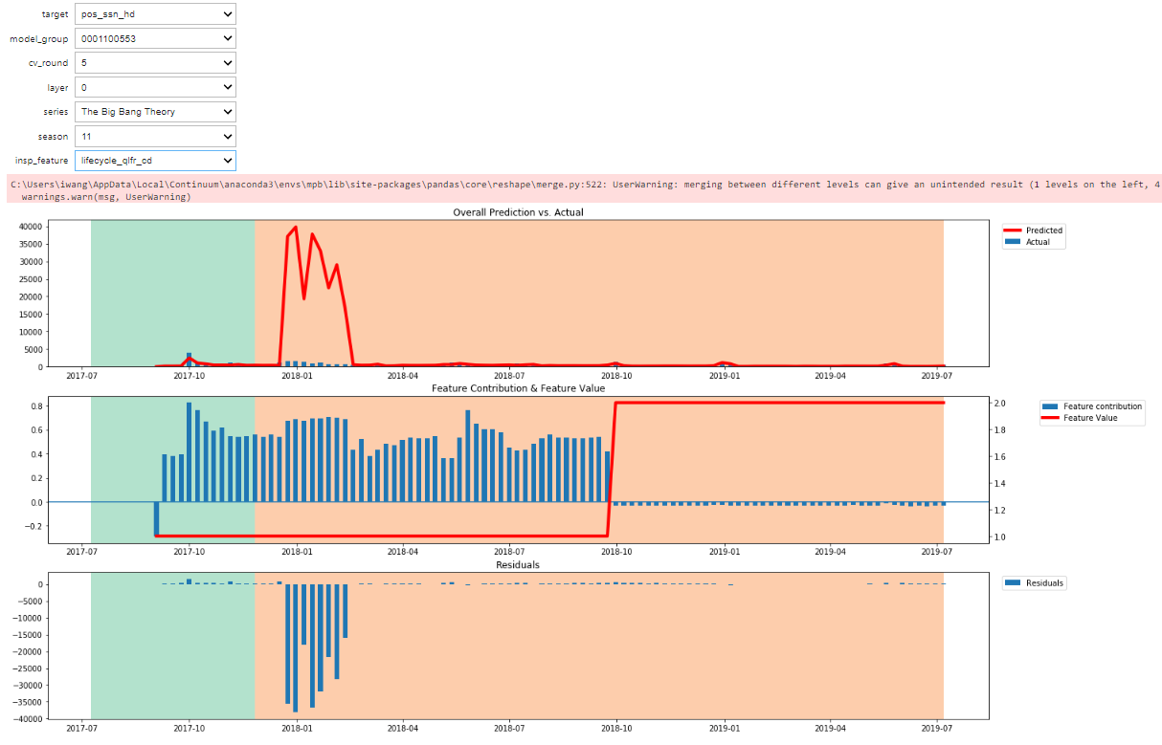
Error Investigation Example
Ranked #2: Lifecycle Qualifier
Notes:
MPB - Post Diagnostics v21.ipynb
7.1 Residual Distribution by Subject

Slide 33
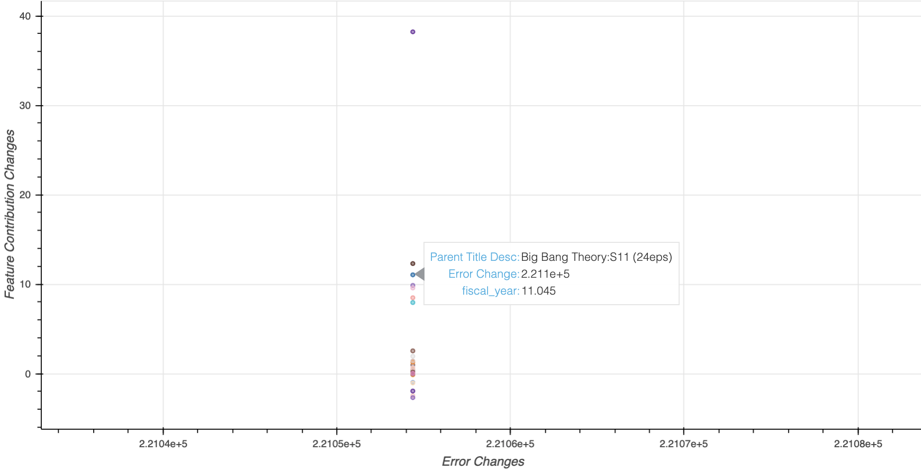
Error Investigation Example
All feature contribution changes for The Big Bang Theory Season 11
Ranked #3: Fiscal Year
Warner Bros. Home Entertainment – Television Marketing
33
Notes:
MPB - Post Diagnostics v21.ipynb
6. Error Source Detector

Slide 34
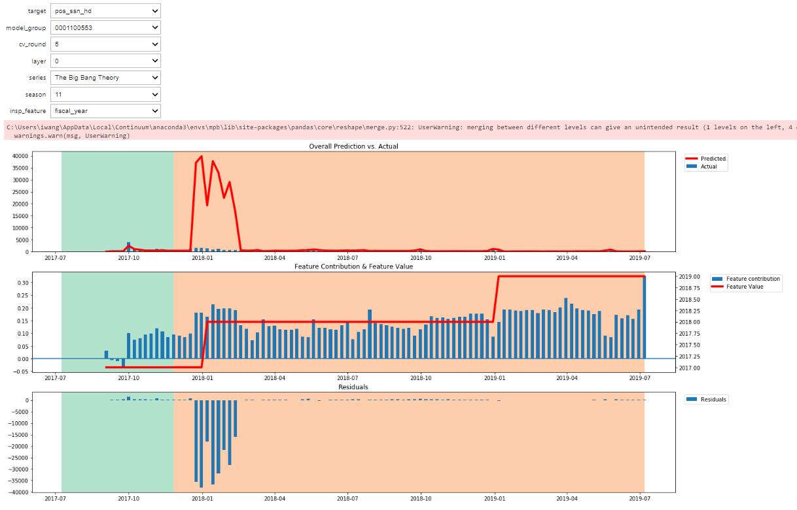
Error Investigation Example
Ranked #3: Fiscal Year
Notes:
MPB - Post Diagnostics v21.ipynb
7.1 Residual Distribution by Subject

Slide 35
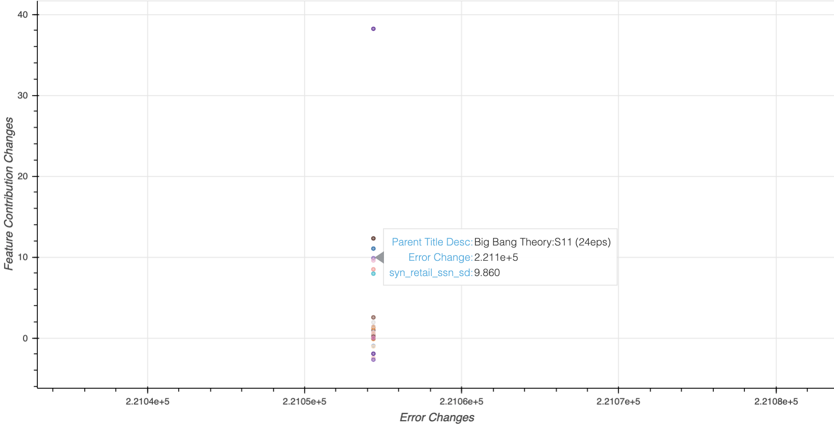
Error Investigation Example
All feature contribution changes for The Big Bang Theory Season 11
Ranked #4: EST Season SD Price
Warner Bros. Home Entertainment – Television Marketing
35
Notes:
MPB - Post Diagnostics v21.ipynb
6. Error Source Detector

Slide 36
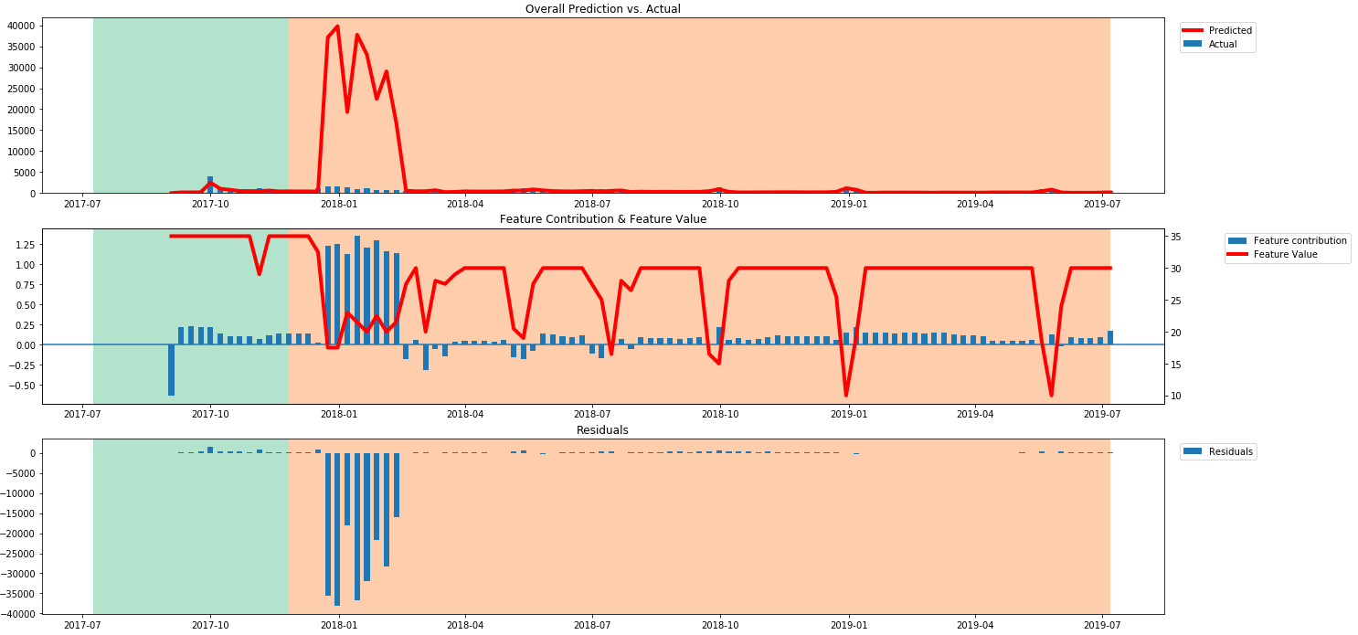
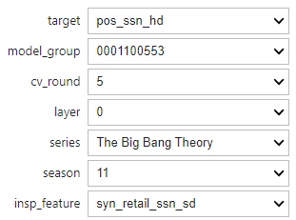
Error Investigation Example
Ranked #4: EST Season SD Price
Notes:
MPB - Post Diagnostics v21.ipynb
7.1 Residual Distribution by Subject

Slide 37
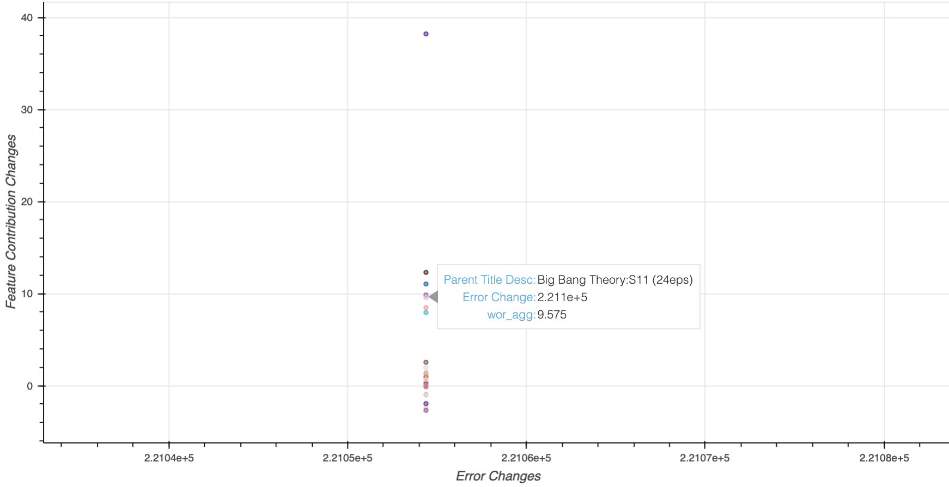
Error Investigation Example
All feature contribution changes for The Big Bang Theory Season 11
Ranked #5: Weak of Release
Warner Bros. Home Entertainment – Television Marketing
37
Notes:
MPB - Post Diagnostics v21.ipynb
6. Error Source Detector

Slide 38
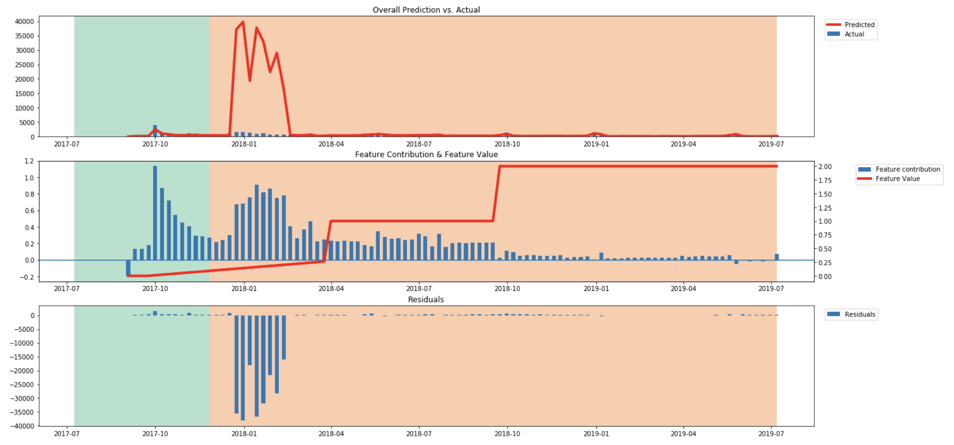
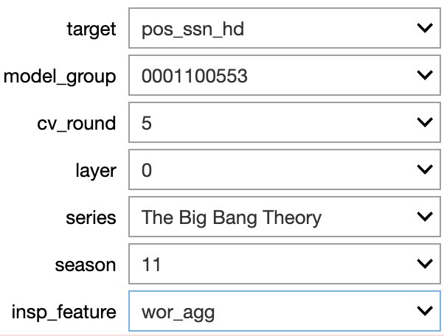
Error Investigation Example
Ranked #5: Weak of Release
Notes:
MPB - Post Diagnostics v21.ipynb
7.1 Residual Distribution by Subject

Slide 39
Contents
Objectives
Data & Pre-Diagnostics
Model Results
Full Model Results
Cross Validation Result
Realized Effects
Post Diagnostics
Concept
Parallel Custom Objective
Model and Helper Classes
Next Steps

Slide 40
Custom Objective Function
Go to Parallel Objective notebook

Slide 41
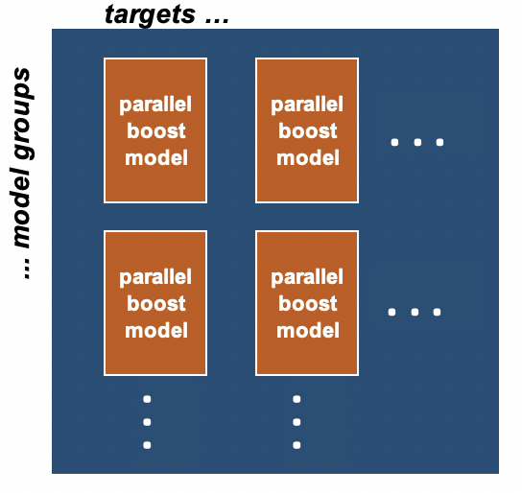
Model Classes
We have built 2 model classes:
Parallel Boost (modeling object)
Current approach uses the TV series as the subject
We call our current approach Bag Boost. Each iteration of the gradient boosting model is trained using a different random subset of TV series.
Multi-Parallel Boost (helper object)
This allows us to fit and predict multiple clients and targets at the same time
Create a parallel boost model for 2 clients (Amazon and iTunes) and for 2 product types (HD and SD season pass units)
(product types)
(clients)

Slide 42
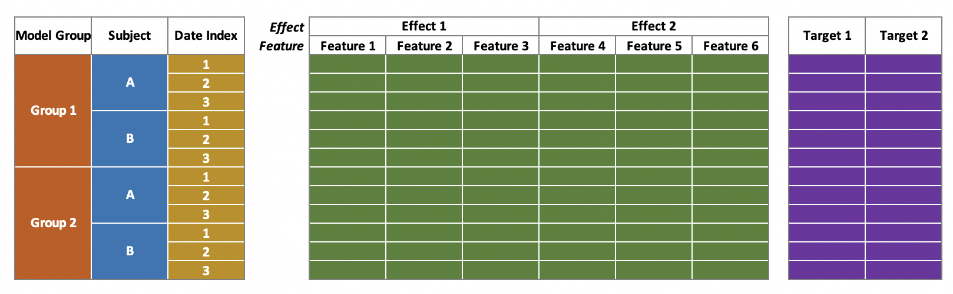
Framer Class
The Framer class creates the feature data frame and target data frame
In the format expected by the Multi-Parallel Boost class
Index Training Features Training Targets

Slide 43
Contents
Objectives
Concept
Parallel Custom Objective
Model and Helper Classes
Data and Pre-Diagnostics
Model Results
Full Model Results
Cross Validation Results
Post Diagnostics
Realized Effects
Next Steps

Slide 44
Technical Debts – Data
Expand viewership feature set
Break by target network (currently using prime time & all time slots aggregate)
Use PCA to transform viewership features
How to handle amazon terms dispute in date?
Feature Expansion
Promotion attributes
Merchandising
Bundle availability
Target networks
Other Potential Features
Social trends
Key beats (critical episodes, announcements, celebrity news, etc.)
Miscellaneous items: Infinite values in pricing features, missing title IDs in attribute table
Notes:
Code Clean-Up and Expansion
Redundancies and conflicts have built up in the framer object.
Need to add residual correlation diagnostics
Implement the BagBoostLayer learner with xgboost.
BagBoostLayer does not support lightgbm categorical features. Should this be fixed or addressed by implement xgboost? Or just on—hot encode the categorical features?
Layering Concept
Layering concept is not working for the BagBoostLayer learner.
Considerations:
Should this be fixed or abandoned? Can the booster object use an expanding feature sets while training?
Want to add subject identifiers to model after the first layer.
Want to use trend layers to help forecast trends.
Layers will allow the subject to change from layer-to-layer (i.e series to title)
Create a layer for correcting residual correlation
Modeling:
Is this the best way to address the model bias?
Compare current model to simple gradient boosting example. Clearly outline pros and cons for new approach
Parameter tuning

Slide 45
Technical Debts – Python Codes
Clean-Up
Redundancies and conflicts have built up in the framer object
Expansion
Need to add residual correlation diagnostics
Implement the BagBoostLayer learner with XGBoost.
BagBoostLayer does NOT support LightGBM categorical features
Should be fixed or addressed by implementing XGBoost?
Just one-hot encode the categorical features?
Notes:
Data Expansion:
Promotion attributes
Merchandising
Bundle availability
Target networks
Expand viewership feature set
Current using prime time and all time slots aggregate, but would like to break by target network.
Use PCA to transform viewership features
Social trends?
Key beats (critical episodes, announcements, celebrity news, etc)
How to handle amazon terms dispute in date?
Forecasting and Scenarios:
If using trend layers to forecast, then need to expand detail and diagnostics for the trend projection.
Need to clean up subject center assumptions to support forecasting new subjects
Diagnostics and dashboard to review subject center and to support subject center assumptions for forecasting
Scenario builder to support pricing and promotion optimization?
Business:
Need to translate units into revenue.

Slide 46
Technical Debts – Model
Layering
Layering concept NOT working for the BagBoostLayer learner (Fix or abandon?)
Feature expansion while training? (Booster object)
Add subject identifiers to model after the first layer
Use trend layers to help forecast trends
If using trend layers to forecast, need to expand details and diagnostics for the trend projection
Allow to change subjects from layer to layer (i.e. series to title)
Create a layer for correcting residual correlation

Slide 47
Technical Debts – Model (Cont.)
Modeling
The best way to address the model bias?
Current model underestimates in training data and over forecasts
CW shows are struggling in the model; On-air shows outperform off-air shows in the model
Compare current model to simple gradient boosting (clearly outline pros and cons)
Parameter tuning (take time-series data into consideration)
Number of trees
Learning rates
Column sampling size
Bagging size
Min data in leaf
Max depth?
Sample weight?

Slide 48
Next Steps
Forecasting Purpose
Clean up subject center assumptions to support forecasting new subjects
Diagnostics and dashboard to review subject center and to support subject center assumptions for forecasting
Scenario builder to support pricing and promotion optimization? (price recommendation)
Business Purpose
Need to translate units into revenue
Tool Development
Distinct count of feature values per subject
Raw data exploration tool (now using Tableau)

Slide 49
Thank you, questions?

Slide 50
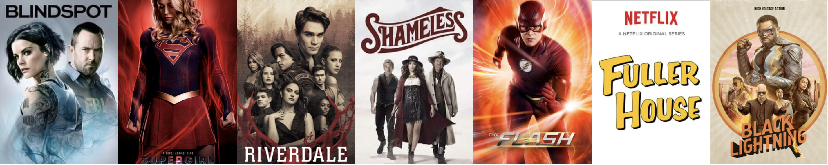
Appendix

Slide 51
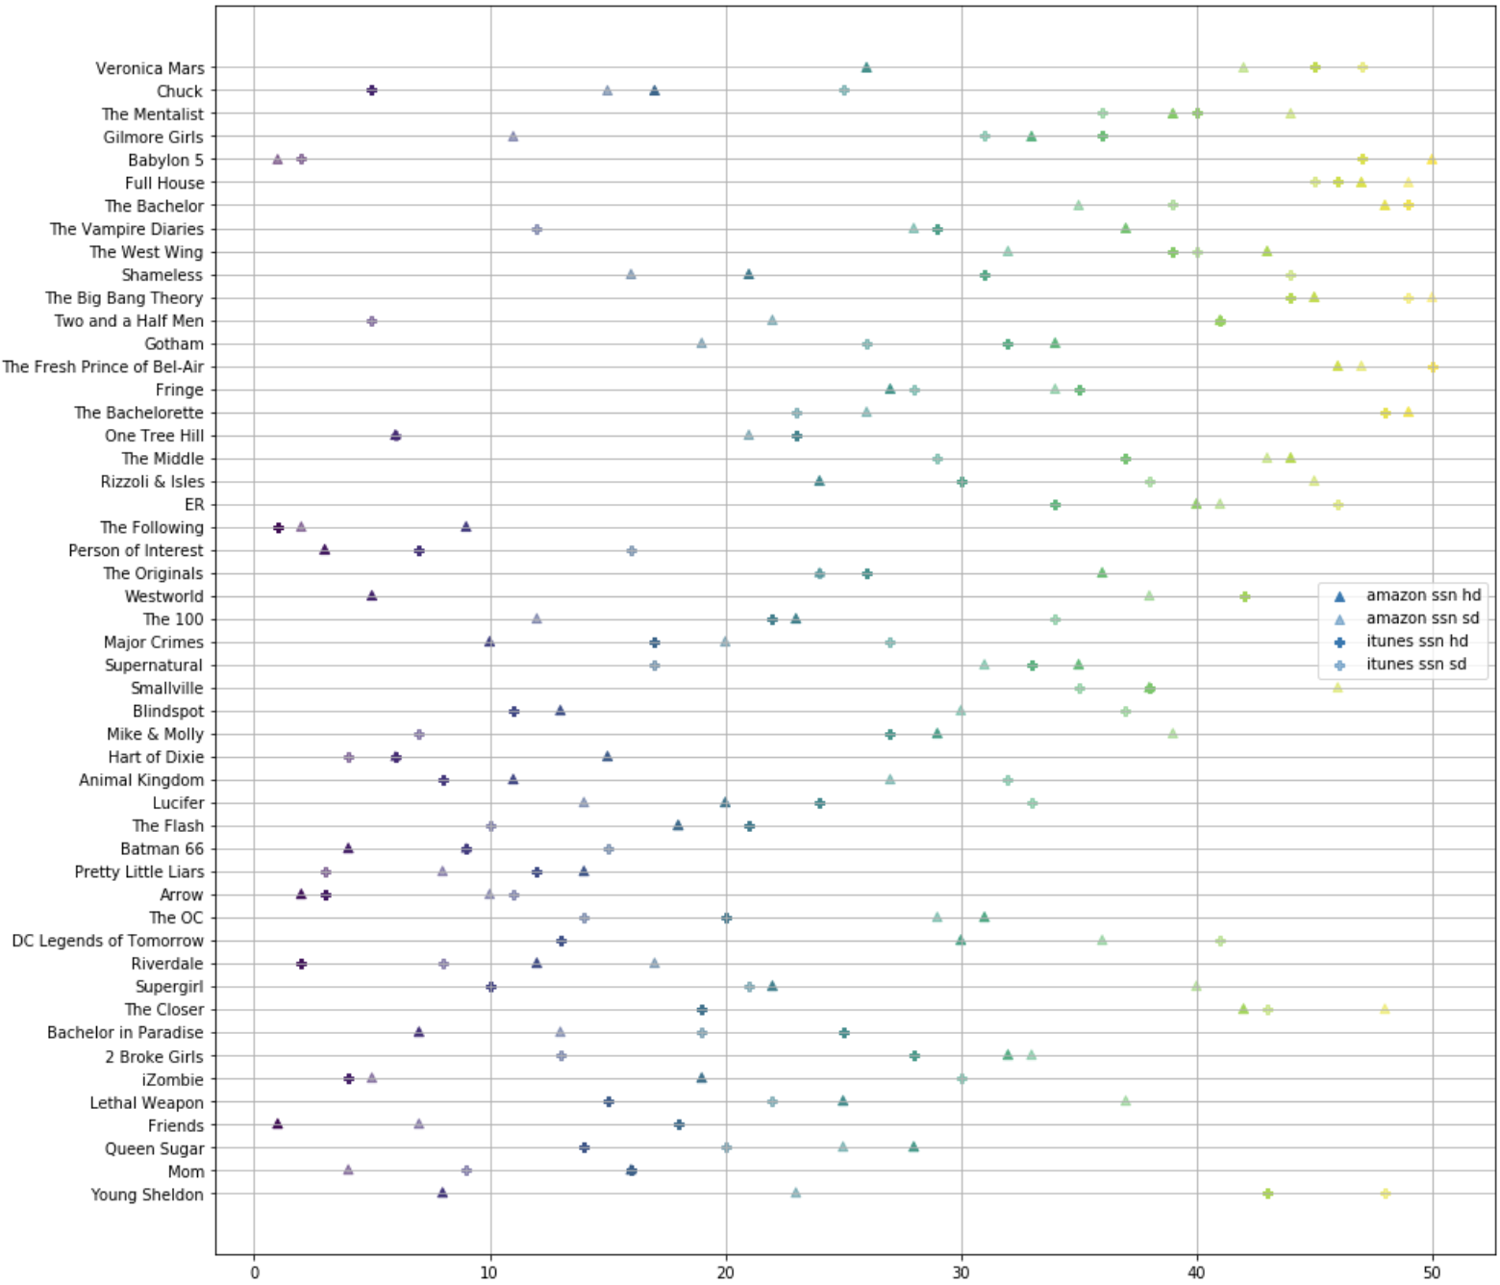
Residual Analysis by Series/Feature (Post Diagnostics)
Residual Variance by Series (Ranking)
Notes:
Residuals by Series & Feature Analysis (for packaging) v2.ipynb
2.1 Residual Distribution by Subject

Slide 52
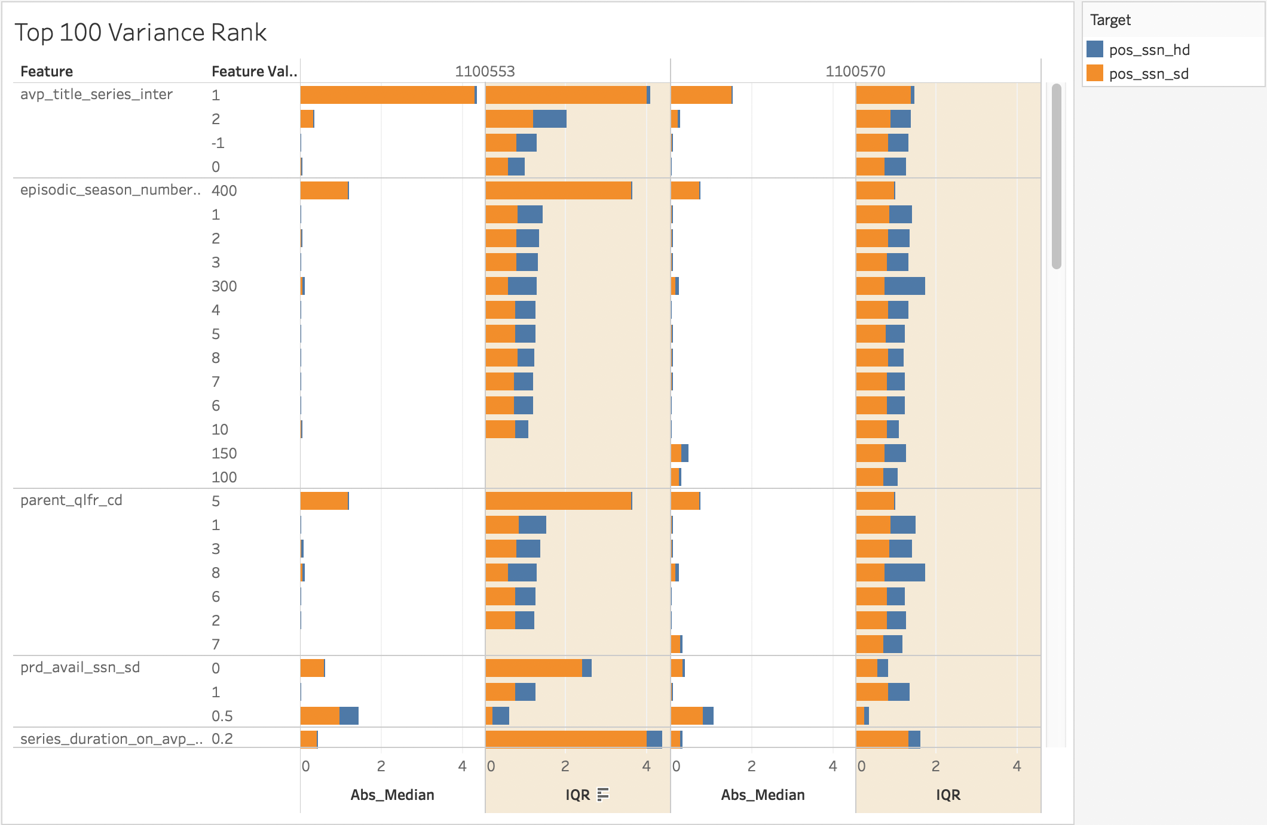
Residual Analysis by Series/Feature (Post Diagnostics)
Residual Variance by Feature
Notes:
Residuals by Series & Feature Analysis (for packaging) v2.ipynb
2.2 Residual Distribution by Feature

